Slide 1
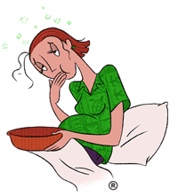
Nausea and Vomiting in Pregnancy:
Pharmacologic and
Non-Pharmacologic Approaches
Harini Kumar, PGY-1
5/5/09

Slide 2
Case Presentation:
HPI: Ms. P is a 30 y/o G4P2012 @ 13 wks 2/7 days seen in clinic for her second pre-natal visit.
LMP 12/3/08, EDD 9/9/09 based on LMP. Today pt. reporting continued nausea and vomiting, since the onset of her pregnancy. Pt reporting unable to keep food down. Reporting 4Ib weight loss since the onset of pregnancy . Pt. reports these symptoms persisted throughout the duration of her first two pregnancies.
Pt. denying HAs, blurry vision, RUQ pain
Past OB Hx:
1999, FT female, 7Ibs, NSVD, no complications
2004, FT female, 6 Ibs, NSVD, no complications
2008, 16 wks, elective D&C
Past Gyn hx: 16/30 days/5-6 days; regular periods; no h/o STDS; no h/o fibroids, polyps, cysts
Past Medical Hx: HTN
PSHx: none
Family Hx: DM, HTN
Social Hx: lives with husband, two children, and father-in-law; denies toxic habits; denies domestic violence; homemaker

Slide 3
Medications: prenatal vitamins; methyldopa 250 BID Physical Exam: VS BP: 120/70 HR: 90 R: 20 Gen: comfortable; NAD HEENT: MMM CV: S1 S2 RRR -murmurs Resp: CTA b/l GI: +BS soft, NT/ND Extremities: no edema b/l Neuro: pt ambulating, no gross deficits; 2+ DT reflexes Labs: urine: SG 1.020; neg protein, neg glucose, neg protein, neg ketones Further workup for the nausea and vomiting?

Slide 4
Definitions
Morning Sickness—nausea with or without vomiting; typical course—symptoms occur at 5-6 wks GA, peak at 9 wks, ablate by 16 to 18 wks;
Occurs in 50-90% of all pregnancies
Symptoms can occur any time of day—80% persist throughout the day
Hyperemesis Gravidarum—persistent vomiting accompanied by weight loss exceeding 5% of body weight; dehydration, ketonuria unrelated to other causes;
Onset usually 4 to 10 wks GA
Affects 1 in 200 pregnancies
Can persist until delivery; symptoms tend to improve in last half of pregnancy
Notes:
Morning sickness occurs in 50-90 percent of all pregnancies. Symptoms can occur at time of day—80 percent persist throughout the day;

Slide 5
Pathogenesis
Hormonal changes-peak in the serum concentration of human chorionic gonadotropin (hCG); increase prevalence in pts with gestational trophoblastic dz (HIGH LEVELS OF HCG)
Gastric Motility—studies have shown gastric motility may be delayed or dysrhythmic;
Psychological factors—a) conversion or somatization disorder b) response to stress c) feelings of ambivalence about the pregnancy
Other-nutrient deficiencies( zinc); genetic factors; changes in autonomic nervous system; infection with H. Pylori
Notes:
HCG levels peak during the first trimester; hCG is higher in women with hyperemesis than in other pregnant women.
Studies addressing motility disturbances have shown conflicting results;

Slide 6
What we can do......The Workup
Hyperemesis is a diagnosis of exclusion, occurs early in pregnancy; N/V occurring after 10wks GA likely not due to hyperemesis
Thorough history and complete physical exam
ROS: abd pain, fever, HA, goiter, abnormal neuro findings, diarrhea, constipation, HTN
DDX………Extensive….
Notes:
Usually n/v in early pregnancy is self limited

Slide 7
Diff Diagnosis of nausea and vomiting
Medications and toxic etiologies
Cancer chemotherapy
Severe-cisplatinum, dacarbazine, nitrogen mustard
Moderate-etoposide, methotrexate, cytarabine
Mild-fluorouracil, vinblastine, tamoxifen
Analgesics
Aspirin
Nonsteroidal anti-inflammatory drugs
Auranofin
Antigout drugs
Cardiovascular medications
Digoxin
Antiarrhythmics
Antihypertensives
-blockers
Calcium channel antagonists
Diuretics
Hormonal preparations/therapies
Oral antidiabetics
Oral contraceptives
Antibiotics/antivirals
Erythromycin
Tetracycline
Sulfonamides
Antituberculous drugs
Acyclovir
Gastrointestinal medications
Sulfasalazine
Azathioprine
Nicotine
CNS active
Narcotics
Antiparkinsonian drugs
Anticonvulsants
Antiasthmatics
Theophylline
Radiation therapy
Ethanol abuse
Jamaican vomiting sickness
Hypervitaminosis

Slide 8
Infectious causes
Gastroenteritis
Viral
Bacterial
Nongastrointestinal infections
Otitis media
Disorders of the gut and peritoneum
Mechanical obstruction
Gastric outlet obstruction
Small bowel obstruction
Functional gastrointestinal disorders
Gastroparesis
Chronic intestinal pseudo-obstruction
Nonulcer dyspepsia
Irritable bowel syndrome
Organic gastrointestinal disorders
Pancreatic adenocarcinoma
Inflammatory intraperitoneal disease
Peptic ulcer disease
Cholecystitis
Pancreatitis
Hepatitis
Crohn's disease
Mesenteric ischemia
Retroperitoneal fibrosis
Mucosal metastases
CNS causes
Migraine
Increased intracranial pressure
Malignancy
Hemorrhage
Infarction
Abscess
Meningitis
Congenital malformation
Hydrocephalus
Pseudotumor cerebri
Seizure disorders
Demyelinating disorders
Emotional responses
Psychiatric disease
Psychogenic vomiting
Anxiety disorders
Depression
Pain
Anorexia nervosa
Bulimia nervosa
Labyrinthine disorders
Motion sickness
Labyrinthitis
Tumors
Meniere's disease
Iatrogenic
Fluorescein angiography

Slide 9
Endocrinologic and metabolic causes
Pregnancy
***preeclampia
***HELLP syndrome
***fatty liver of pregnancy
Other endocrine and metabolic
Uremia
Diabetic ketoacidosis
Hyperparathyroidism
Hypoparathyroidism
Hyperthyroidism
Addison's disease
Acute intermittent porphyria
Postoperative nausea and vomiting
Cyclic vomiting syndrome
Miscellaneous causes
Cardiac disease
Myocardial infarction
Congestive heart failure
Radiofrequency ablation
Starvation
Notes:
*** these are pregnancy related and occur in the latter half of pregnancy

Slide 10
Workup…
Weight; orthostatic blood pressure; serum free T4 concentration; TSH; serum electrolytes; urine ketones; CBC; LFTs
Hyperthyroidism vs. hyperemesis
Ultrasound examination—performed to exclude gestational trophoblstic dz and multiple gestation
Notes:
Electrolytes—hypokalemia and metabolic alkalosis
Increase in hematocrit—hemoconcentration
LFTS—increase in aminotransferases– mildly elevated
Amylase and lipase—can increase as much as 5 fold—salivary rather than pancreatic in ori
Mild hyperthroidism---high HCG which has throid simulating activity—LOW TSH;
Vomiting, absence of goiter and opthalmopathy; absence of the common signs of symptoms of hyperthy heat intol, muscle weakness, tremor—
T4 minimally elevated and T3 not elevated– both are elevated in true hyperthy

Slide 11
Non-Pharmacologic Treatments:
Avoidance of environmental triggers, especially strong odors
Powdered ginger extract 1g/day or ginger capsules 250 mg TID or QID*
Acupressure wristbands (acupuncture pressure point pericadium 6)
Acupuncture (pressure points liver meridian 3 and spleen 6)
Psychotherapy
Hypnotherapy

Slide 12
Non-pharm Interventions Continued….
Diet—frequent high carb, low fat, small meals; eliminate spicy food, salty food, high protein snacks/meals; food better tolerated if cold, clear, carbonated, sour; aromatic therapies (lemon, mint, orange); avoid supplements containing iron—causes gastric irritation
Triggers—avoid environmental triggers—stuffy rooms, odors, heat, humidity, noise, physical motion; avoid brushing teeth after eating; get adequate rest;
Psychological—provide emotional support; addressed depressed mood and affect changes; inquire about domestic violence; inquire about psychiatric history

Slide 13
Non-Pharm Interventions Continued…
Ginger—use in teas, preserves, ginger ale, capsule.;
Review article: ginger is effective in reducing nausea and vomiting;
dose range between 500-1500 mg/day;
adverse effects—uncommon, GI upset, heartburn, diarrhea, mouth/throat irritation
no higher incidence of birth defects, miscarriages, or deformities
not universally recommended without more large scale trials of efficacy and safety—pregnancy category C
use in first trimester
good option for pts not responding to pharm methods
Boone, S and Shields K. Treating Pregnancy-Related Nausea and Vomiting with Ginger. The
Annals of Pharmacology 2005; 39: 1710-1713.

Slide 14
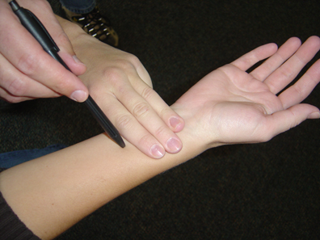
Acupuncture and Acupressure
Notes:
Pressure or massage at the P6 acupressure point is reported in some studies to relieve motion sickness. The point is found three of the patient's fingerbreadths proximal to the proximal wrist fold, between the palmaris longus and flexor carpi radialis tendons, shown in this picture by the tip of the pen.

Slide 15
Acupressure
Constant pressure to specific anatomic areas; noninvasive form of acupuncture;
Scientific analysis is weak
Physiological basis for acupressure is not described
7 day community based clinical trial:
O’Brien et al. Efficacy of P6 acupressure in the treatment of nausea and vomiting during pregnancy. AM J Obstet and Gyn 1996; 174: 708-715

Slide 16
Notes:
he Sea-Band is a knitted elasticated wrist band, which operates by applying pressure on the Nei Kuan acupressure point on each wrist by means of a plastic stud. Because the bands do not use drugs, they do not cause any of the side effects associated with anti-nausea drugs and can be worn on each wrist whenever you feel nauseous. They are suitable for adults and children.

Slide 17
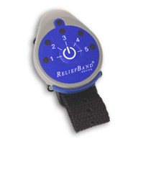
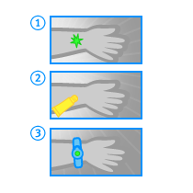
Notes:
hen you experience nausea, this rhythm becomes erratic. The ReliefBand® uses mild electrical stimulation of the median nerve, located on the underside of your wrist, to send a message through the brain that can make the stomach rhythm return to normal. Fast & easy reliefSince the ReliefBand is not a drug, you can start to feel results within minutes. And ReliefBand doesn't have drug side effects, like headaches, dizziness, or drowsiness, or rules about what not to eat or drink while you're wearing it.With its 5 adjustable settings, the ReliefBand can give you the power to control your nausea naturally. Original batteries can last up to 150 hours. If you run out of battery power, just replace the batteries for continued use.

Slide 18
Pharmacologic approach:
Pyridoxine (vitmain B6)—useful for morning sickness; was on market with Doxylamine( antihistamine)—available as Unisom—combination Dilectin is available in Canada
Antihistamines/Anticholinergics—promethazine (Phenergan); dimenhydrinate (Dramamine)
Antiemetic—Ondansetron (Zofran)—serotonin receptor antagonist;
Motility Drugs( dopamine antagonists)—Reglan—increases pressure in the lower esophageal sphincter & speeds transit through the stomach; Prochlorperazine( dopamine antagonist); Droperidol
Corticosteroids—use has been in severe and refractory hyperemesis; --two week tapering regimen
IV fluids—NS or LR; dextrose; give thiamine( risk of Wenicke’s); replete mag, phos, potassium; +/- antiemetic;
Enteral/Parenteral Nutrition—last resort; gastric or duodenal intubation; parenteral via PICC

Slide 19
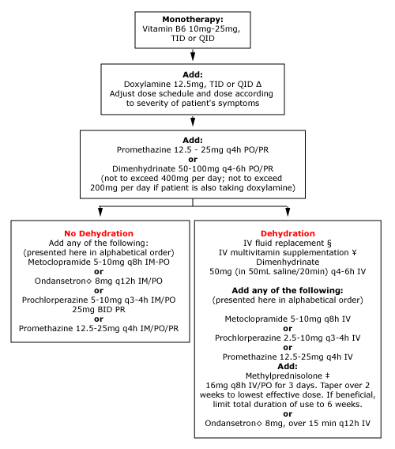

Slide 20
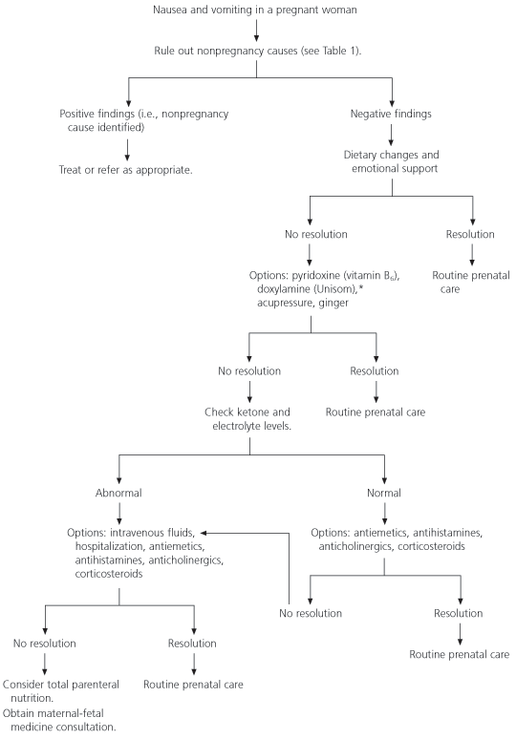

Slide 21
Medication Dosage* Pregnancy category
Pyridoxine (Vitamin B₆)† 25 mg orally three times daily A‡
Doxylamine (Unisom)† 25 mg orally once daily §
Antiemetics
Chlorpromazine (Thorazine) 10 to 25 mg orally two to four times daily C
Prochlorperazine (Compazine) 5 to 10 mg orally three or four times daily C
Promethazine (Phenergan) 12.5 to 25 mg orally every four to six hours C
Trimethobenzamide (Tigan) 250 mg orally three or four times daily C
Ondansetron (Zofran) 8 mg orally two or three times daily B
Droperidol (Inapsine) 0.5 to 2 mg IV or IM every three or four hours C
Antihistamines and anticholinergics
Diphenhydramine (Benadryl) 25 to 50 mg orally every four to eight hours B
Meclizine (Antivert) 25 mg orally every four to six hours B
Dimenhydrinate (Dramamine) 50 to 100 mg orally every four to six hours B
Motility drug
Metoclopramide (Reglan) 5 to 10 mg orally three times daily B
Corticosteroid
Methylprednisolone (Medrol) 16 mg orally three times daily; then taper C
American Family Physician, Table 2

Slide 22
Back to the case….
Ultrasound—single, IUP
Vital signs stable; Physical Exam-well hydrated;
Labs: TSH=0.742
Chem 7 136 103 7
4.3 19 0.6 78
CBC: WBC 7.4; H/H=13.6/41.0; Plts 354
LFTs=WNL
prenatal labs: HIV neg, HepBSAg neg, Rubella Immune, RPR neg, GC/Chl neg; PAP negative
Treatment: counseled on diet; pyridoxine 10-25 mg PO TID
Follow-up: 20 weeks, nausea and vomiting resolved; gained two pounds

Slide 23
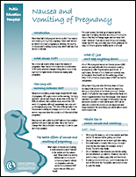
Information for Patients:
http://www.sogc.org/health/pregnancy-nausea_e.asp#length
www.uptodateonline/patients

Slide 24
References
Quinlan et al. Nausea and Vomiting of Pregnancy. American Family Physician;
July 1 2003.
Boone, S and Shields K. Treating Pregnancy-Related Nausea and Vomiting
with Ginger. The Annals of Pharmacology 2005; 39: 1710-1713.
O’Brien et al. Efficacy of P6 acupressure in the treatment of nausea and
vomiting during pregnancy. AM J Obstet and Gyn 1996; 174: 708-715
Sheehan, P. Hyperemesis gravidarum: Assessment and Management
Australian Family Physician. 2007; 36: 698-701
American Gastroenterologial Association. Gastroenterology 2001; 120: 263.
Levichek at al. Nausea and Vomiting of Pregnancy. Evidence-based treatment algorithm. Can Fam Physician 2002; 48: 267.
http://www.uptdol.com
http://www.sogc.org/health/pregnancy-nausea_e.asp#length
www.reliefband.com
www.sea-band.com

